Slide 1
Introduction to LabVIEW Real-Time and FPGA
Notes:
Presenters - for questions or troubleshooting, please contact:
Casey Weltzin
Product Manager, LabVIEW Real-Time
casey.weltzin@ni.com
521.683.6269
This presentation is a surface-level introduction to real-time and FPGA technology, as well as the LabVIEW Real-Time and FPGA modules and the associated hardware they are used to program. This session is not meant to teach attendees how to actually use the products; it is recommended that they attend a hands-on session or training course as a next step.
At the end of this session attendees should be familiar with real-time and FPGA concepts including jitter, determinism, and reprogrammable hardware. They should have a basic understanding of what the LabVIEW Real-Time and FPGA modules are used for, and the software and hardware architecture of a typical RIO system.

Slide 2
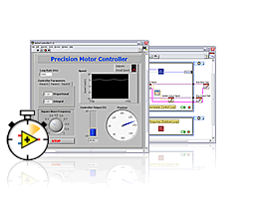
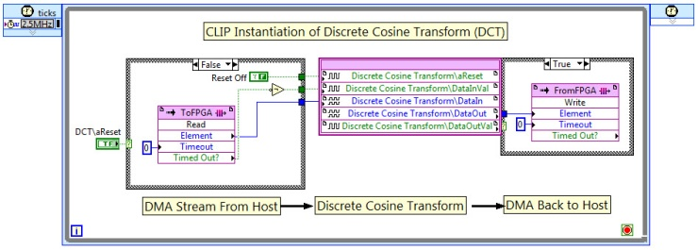
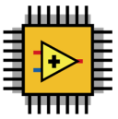
LabVIEW 2010 Real-Time Module
LabVIEW 2010 FPGA Module
Add-on for creating deterministic, stand-alone systems
Add-on for programming reconfigurable FPGA hardware using graphical programming
Notes:
In this session, we will discuss real-time and FPGA technology. Specifically, we will talk about the LabVIEW Real-Time and FPGA module add-ins that can be used to develop and deploy code to CPUs running real-time OSs as well as FPGAs.

Slide 3
Part 1: Understanding Real-Time Systems and LabVIEW Real-Time

Slide 4



Critical Applications to Consider
Event Response
Closed-Loop Control
Critical Tests
Notes:
Let’s start by considering some “critical applications”.
One type of application that can be considered critical is a category called event response. For example, imagine an air-bag system. The system must perform its intended task (deploying the air-bag) within a certain amount of time very reliably. If it takes too long, then the system is completely useless. The passenger may be seriously injured or even die.
Another type of critical application is closed-loop control. Consider any aircraft. Sensors must detect when the aircraft is tilted in a given direction, and then a control system must act in a certain amount of time to adjust flight surfaces to compensate for that tilt. If the delay between input and output is too great, the aircraft will fall out of the sky.
Finally, a third type of critical application is testing in situations where data is extremely important. For example, imagine a test system that it set up to monitor strain levels on a bridge over the course of a week to evaluate whether certain segments need to be replaced. If the test system takes data periodically and misses some data points, then a large vehicle could drive over and the strain data could be lost during that time. In the end, engineers may make the wrong decision about replacing bridge segments. Here, the system timing requirements may be more relaxed (maybe a sample every few seconds), but reliability is still very important.
What do these all have in common? These systems are characterized by a need for reliability (up-time) and in many cases precise timing as well.

Slide 5
When General Purpose OSs Fall Short
Design for fairness and user responsiveness vs. strictly prioritizing tasks
Focus on multitasking instead of maximum reliability / uptime
Not the result of bad products, only certain design goals
Notes:
So how do we build these systems? Well, a first-pass solution might be to use some kind of a computer running a general-purpose operating system (OS) such as Windows. However, there are a few reasons why this type of system isn’t a good fit for critical applications.
General-purpose OSs are designed to ensure that all tasks receive some CPU time, which is great for users that need a responsive UI (e.g. the mouse cursor updates on the screen even when a program is using a lot of CPU cycles). However, this means that if a critical application is running, it may be ignored for some time so that a lesser priority application receives some CPU cycles. If that critical application is something like a flight control system, then the system may fail (i.e. the airplane could fall out of the sky).
Note that the conclusion here is not that general-purpose OSs are “bad”. They are simply designed for a different use case than critical applications.

Slide 6
Key Careabouts for Critical Applications
Jitter: execution time variability of a given operation or application
2.8
Mean = 2.03 us
2.1
2.1
2
Jitter
1.9
Execution Time (ms)
1.3
Iterations
Notes:
So, if general-purpose OSs aren’t the right solution, then what do we need? Let’s consider the timing between iterations of a critical program (e.g. flight control system). Imagine that the loop rate of the application is programmed to be 2 ms. The first iteration may take 2 ms, while the second iteration may be a bit faster due to less interrupts or other applications that demand CPU time. Likewise, the timing of each subsequent loop iteration will vary by a certain amount.
On average, the varying loop periods should equal about 2 ms. We can then measure the variation in time between the average and the worst-case deviation – this is called “jitter”. In practice, jitter can be measured in different ways, but the main point is that it is a measure of the variation in timing between program iterations.

Slide 7
Key Careabouts for Critical Applications
Determinism: a condition that is met if an operation or application has bounded jitter
Bound (for hard real-time systems)
2.8
Mean = 2.03 ms
2.1
2.1
2
Jitter
1.9
Execution Time (ms)
1.3
…n
Iterations
Notes:
For critical applications, we need to ensure that the jitter is small to avoid a situation where one iteration takes too long and the system fails (e.g. the airbag fails to deploy, the plane falls out of the sky, or the bridge measurement isn’t taken).
Ideally, the jitter would have some maximum bound that would never be exceeded. Applications or operations that have this maximum bound are called “deterministic”. Entire systems that can predictably meet a worst-case time constraint can also be referred to as deterministic.

Slide 8
Using a Real-Time Operating System (RTOS) for Reliability and Precise Timing
Designed with critical, stand-alone applications in mind (minimal, bounded jitter)
Use advanced schedulers to ensure that key pieces of code take precedence over others
Minimize interrupt and thread switching latencies
Notes:
So what kind of operating system can meet these constraints (low, bounded jitter)? A category of OSs called Real-Time Operating Systems (RTOSs) exist that are designed differently than general-purpose OSs. They use advanced schedulers to ensure that important pieces of code take priority over other less important pieces (based on input from the designer). In addition, they minimize the latencies associated with interrupts and thread switching in order to reduce program jitter.
The end result is that systems featuring real-time OSs that are programmed correctly can present a lower risk of failure – something that is important for critical applications that require precise timing or reliable operation over an extended period of time.

Slide 9

Real-Time System Design
Editor, Compiler, and Linker
Debugging and Analysis Tools
Development Tools
Real-Time Operating System (RTOS)
System Components
Board Support
Additional I/O Drivers
Notes:
In practice, an entire real-time system is made up of more than just the operating system. Development tools are needed that can generate applications to run on the real-time OS. Keep in mind that these real-time systems are often dedicated stand-alone systems and so development is done from a different computer. Debugging and analysis tools are also needed that can communicate between the development machine and embedded target to ensure correct operation.
In addition, the real-time operating system must have drivers for both the underlying system hardware and any additional I/O devices – that are explicitly programmed with low jitter in mind. The entire real-time system is only as good as the worst component; all of these pieces need to work together so that the whole system is reliable and has precise timing.

Slide 10
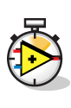
LabVIEW Real-Time Module
Deterministic, hard real-time performance (with SMP support)
Compiler, Linker, Debugging, RTOS, and board support included (requires LabVIEW Full or Pro)
Hundreds of real-time drivers and analysis functions available
Notes:
The LabVIEW Real-Time Module provides access to all of these needed real-time system components. As an add-in to LabVIEW, the Real-Time Module enables users to develop applications that will run deterministically on a stand-alone embedded target (compiler, linker, IDE). In addition, LabVIEW Real-Time has built-in debugging features that provide a similar experience to debugging in LabVIEW for the desktop.
Next, the LabVIEW Real-Time Module comes with a complete Real-Time OS that can be downloaded to NI embedded hardware or a 3rd party PC then programmed with the Real-Time Module.
Finally, hundreds of real-time drivers for NI and other hardware are available, and the LabVIEW Real-Time Module comes with a wide variety of analysis libraries that can be reused in your applications.

Slide 11
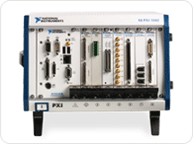
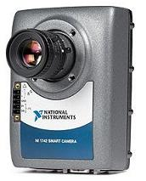
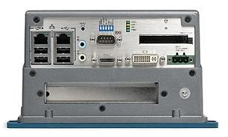
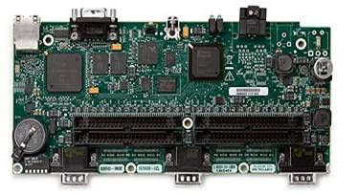
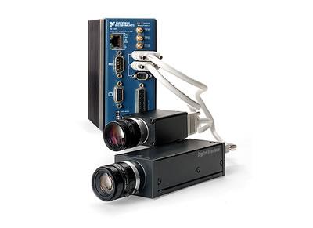
LabVIEW Real-Time Hardware Targets
Notes:
As was just mentioned, the LabVIEW Real-Time Module comes with a complete Real-Time OS that can be downloaded to NI embedded hardware or a 3rd party PC then programmed with the Real-Time Module.
Shown here are some of the embedded hardware targets offered by NI. These range from low-power, low-performance, board-only devices (Single-Board RIO) to more rugged systems (CompactRIO) and even high-performance systems featuring quad-core CPUs (PXI).
All of these targets are capable of operating in a stand-alone (headless) manor.

Slide 12
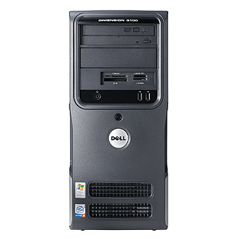
A Different Model for Development, Deployment, and Debugging
Ethernet
Development PC
Deployed Real-Time System
Notes:
Keep in mind that when using the LabVIEW Real-Time Module, applications are typically developed on one computer and then downloaded and run (deployed) to an embedded hardware target. (Presenter: explain the demo system setup/connections here).
In addition, note that the embedded hardware targets running applications developed with the LabVIEW Real-Time Module do not have a built-in user interface. Instead, they are designed to run real-time applications reliably and with precise timing. This does not meant that it is not possible to view data collected by LabVIEW Real-Time hardware targets or send parameters to them; this is a very common design requirement. In practice, a second LabVIEW application is typically created to run on a general-purpose host PC (which could be the development PC), and send data back and forth with the embedded target via Ethernet. We will see a few examples of this architecture today.

Slide 13
Demo: Configuring and Programming a LabVIEW Real-Time System
Notes:
Presenters - for questions or troubleshooting, please contact:
Casey Weltzin
Product Manager, LabVIEW Real-Time
casey.weltzin@ni.com
521.683.6269
Estimated time: 5-10 minutes.
Open the “Demo 1 – Basic RT Temperature Monitor” project file as well as MAX (should be loaded on PXI system for NITS). This project features a Windows user interface application that shows historical temperature data from an embedded CompactRIO monitoring system. A LabVIEW Real-Time VI runs on the CompactRIO and takes measurements from a thermocouple module using Scan Mode.
For time purposes, it is recommended that the presenter explain the application architecture and program elements rather than building the demo on-the-fly. Please feel free to modify as needed.
Recommended steps:
Open MAX and briefly discuss how to detect and change settings on the CompactRIO target
Open the Temperature Monitoring Project file and explain the difference between applications running on the local PC and embedded target
Open the LabVIEW Real-Time VI and note the familiarity with LabVIEW development for Windows. Explain the different parts of the LabVIEW Real-Time application (acquisition from the thermocouple, sending data via Ethernet, looping, etc.). An explanation of Scan Mode and the FPGA will be given later in the presentation.
Note how the LabVIEW Real-Time VI does have a front panel that will automatically publish values to the development PC. However, this is not typically used except for debugging purposes.
Open the user interface VI and explain how it will run on the host PC and communicate with the LabVIEW Real-Time application running on the CompactRIO.
Run the LabVIEW Real-Time and user interface VIs and experiment with warming up the thermocouple and watching the user interface update.
Stop and close both VIs when finished (as well as the project).

Slide 14
Demo: Comparing RTOS and GPOS Jitter
Notes:
Presenters - for questions or troubleshooting, please contact:
Casey Weltzin
Product Manager, LabVIEW Real-Time
casey.weltzin@ni.com
521.683.6269
Estimated time: 5 minutes.
Open the “Demo 2 – Jitter Benchmarking” project file (should be loaded on PXI system for NITS). This project contains identical LabVIEW applications that will be run on the real-time CompactRIO hardware and host PC simultaneously to compare jitter between the two targets.
This is an open-and-run demo only.
Recommended steps:
Explain that now that the audience is familiar with the basic operation of LabVIEW Real-Time hardware targets, we are going to return to the concept of jitter that is important in many critical applications. Specifically, we will compare the jitter between identical applications running on the real-time CompactRIO target and host PC. Open the Benchmark Demo project file.
Open and run both the LabVIEW Real-Time and Windows VIs.
Show execution side-by-side and explain the numerical results. You should see large time-delay spikes in the execution of the LabVIEW VI running on Windows. So, while the average execution time is as-programmed, the jitter is very large. Jitter for the same application running on the CompactRIO target should be lower by at least an order of magnitude.
Stop and close both VIs and the project when finished.

Slide 15
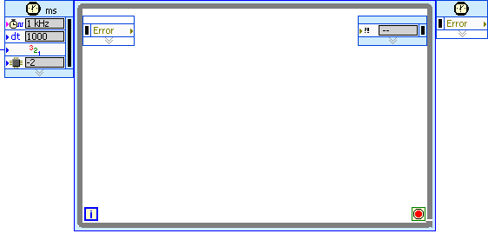
Separating Deterministic and Non-Deterministic Tasks
Critical Loop
Auxiliary Loop(s)
Real-Time FIFOs
Deterministic Operations | Non-Deterministic Operations
PID control Motion control Safety logic Calls to deterministic drivers or libraries | File I/O Network or serial communication Memory allocation Calls to non-deterministic libraries or drivers
Notes:
Now that we have covered the basics of real-time operating systems and how the LabVIEW Real-Time Module can be used to program embedded hardware targets, let’s look deeper at how programming real-time applications differs from typical LabVIEW applications on Windows.
It is important to keep in mind that in order to ensure reliable timing of applications created with the LabVIEW Real-Time module, these applications must be carefully designed. At a high-level, LabVIEW Real-Time VIs typically feature two or more loops. One loop runs critical code with very precise timing (deterministically). The other loops perform other less critical tasks, or tasks that it is not possible to run deterministically.
For example, File I/O and Ethernet communication are two operations that do not have predictable timing (their jitter can not be bounded). Therefore, adding these functions in a critical control loop could cause delays in the loop and ultimately cause failure of the system. Separating deterministic and non-deterministic tasks into separate loops helps avoid this problem.

Slide 16
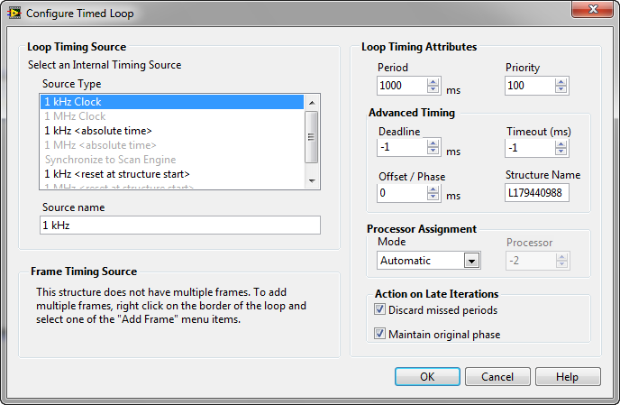
Setting Priorities
Notes:
With many loops and background processes running in a typical LabVIEW Real-Time application, what happens when all available CPU cycles are being used? Which loops take priority over others?
One of the advantages of a Real-Time OS is the ability to, as a programmer, very precisely control the priority of different tasks to dictate what will happen in this situation. The LabVIEW Real-Time Module makes assigning priorities to loops straightforward with the Timed Loop. Shown here is the Configure Timed Loop dialog box that opens up when you double click on the loop. Note the priority control, which is used to set a relative priority between the loops in a VI. When the CPU bandwidth is limited, the Timed Loop with the highest priority will run while others with a lower priority are “starved”. (VI priorities are ignored for now as this is not intended to be a complete review of RT programming practices).
Since this is an introductory session, we do not have time to go into all of the best practices for LabVIEW Real-Time application design. These best practices are shared in the LabVIEW Real-Time Application Development training sessions offered periodically through National Instruments. It is recommended that you take this course prior to deploying your first LabVIEW Real-Time application.

Slide 17
Demo: Simple PID Control System
Notes:
Presenters - for questions or troubleshooting, please contact:
Casey Weltzin
Product Manager, LabVIEW Real-Time
casey.weltzin@ni.com
521.683.6269
Estimated time: 5 minutes.
Open the “Demo 3 – Simple PID Motor Control System” project file (should be loaded on PXI system for NITS). The goal here is to show a more representative real-time control application as a review of the LabVIEW Real-Time section of this presentation. The LabVIEW Real-Time VI in the project takes encoder feedback from a small servo motor along with a user-defined setpoint, and then controls the motor using PID to reach the desired position. The 9505 module is used to measure encoder signals and drive the motor (PWM).
Note: Since the FPGA has not been discussed at this point, it is recommended that you focus on only the LabVIEW Real-Time and host VIs in this demo. For demo simplicity, user-defined IO variables are used in the Real-Time and FPGA VIs in this demo rather than the FPGA host interface. The 9505 can not be used in Scan Mode.
This is an open-and-run demo only.
Recommended steps:
Open the Simple PID Control Project
Explain how the architecture is the same as previously discussed (Real-Time VI and host user interface VI). Only now, we will show something more interesting than a simple temperature measurement.
Open the Real-Time PID Control VI (which will run on the CompactRIO) and explain the main PID control loop (taking encoder measurements and a setpoint and using that to control the motor).
Run the Real-Time VI (it will automatically run the FPGA VI), and open and run the Windows user interface VI. Experiment with changing the position setpoint and watch the motor respond. Emphasize that the precise timing made possible by LabVIEW Real-Time helps avoid motor overshoot and provide predictable motor response time to a change in setpoint.
Stop both VIs (use the stop botton on the LabVIEW Real-Time VI) and close. Close the project as well.

Slide 18
Part 2: Programmable Logic and LabVIEW FPGA

Slide 19
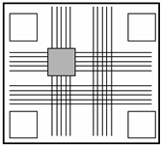
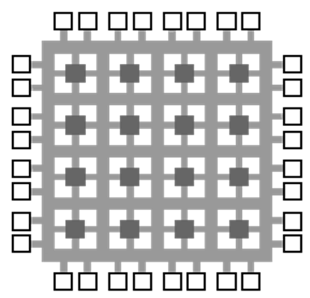
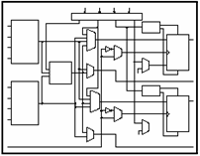
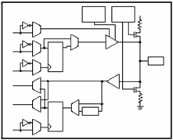
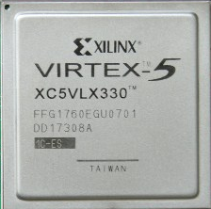
FPGA Technology
Programmable
Interconnects
Logic
Blocks
I/O Blocks
Notes:
FPGA stands for Field Programmable Gate Array, and FPGAs are a key component on most National Instruments embedded hardware targets. They are also used widely by embedded designers in general.
FPGA Logic Blocks are programmed to perform digital logic functions, AND, OR, NAND, XOR, etc
Programmable interconnects route signals differently depending on how the chip is programmed
Pins can connect to I/O circuitry or other logic
Combination is essentially a custom circuit / programmable breadboard

Slide 20
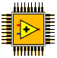
Why Are FPGAs Useful?
True Parallelism – Provides parallel tasks and pipelining
High Reliability – Designs become a custom circuit
High Determinism – Runs algorithms at deterministic rates down to 25 ns (faster in many cases)
Reconfigurable – Create new and alter existing task-specific personalities
Notes:
So, why would a designer want to use a reprogrammable FPGA? These are just some of the reasons:
True Parallelism - Whereas a processor is forced to execute one instruction at a time and use complex scheduling schemes, parallel circuits inside an FPGA operate completely independently.
FPGAs certainly have the reliability and determinism of a pure hardware solution. In fact, with LabVIEW FPGA you can specify loop rates of 25ns and faster achieving extremely low jitter.
FPGAs are reprogrammable unlike other hardware solutions (it is helpful here to make the comparison to burning a CD. Fixed asic like a CD-R, FPGA like a CD-RW)

Slide 21
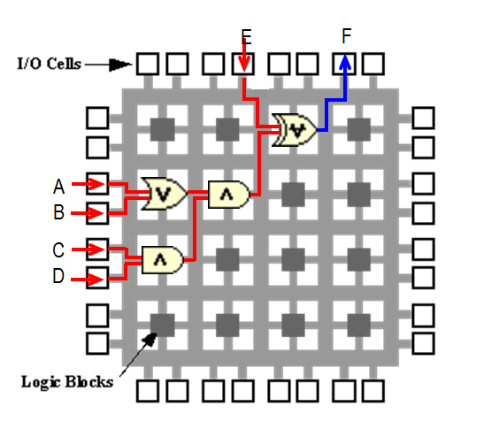
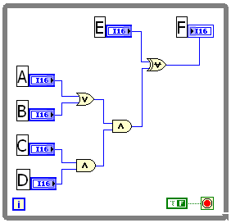
From LabVIEW to Hardware
Translation
Optimization
Synthesis
Bit Stream
VHDL Generation
Analysis
Logic Reduction
Place and Route
Timing Verification
Generation
Download/Run
LabVIEW FPGA Code
FPGA Logic Implementation
Notes:
Traditionally, engineers that wanted to write code to reconfigure an FPGA had to use a hardware description language (HDL). These languages (e.g. VHDL, Verilog) are very different from CPU programming and require specific expertise.
The LabVIEW FPGA Module brings the benefits of FPGAs to more engineers, scientists, and embedded designers. You write LabVIEW code, which is very similar to LabVIEW code written for the PC but with a more limited palette and some different programming structures. When you press the Run button in LabVIEW, your code is actually translated to HDL code automatically, and then it is compiled to generate the bit stream that must be sent to the FPGA to allow it to reprogram itself. Finally, the FPGA starts running your code – in hardware.
Note that NI’s expertise is in graphical programming and we haven’t tried to improve the efficiency of the time-consuming compile process. This is part of the process when programming FPGAs, as code has to be translated into hardware circuitry.

Slide 22
NI LabVIEW FPGA Hardware Targets
NI Single BoardRIO
NI FlexRIO
Industrial Control and Monitoring
Embedded Systems
Manufacturing Test and Design Validation
NI CompactRIO
Other
RIO IF Transceiver
PCIe Framegrabbers
Compact Vision System
R Series Multifunction RIO
General Purpose I/O for Measurement and Control
Notes:
NI provides many options for integrating an FPGA into your designs, whether that means adding an I/O board with an onboard FPGA or building the FPGA into an embedded hardware target:
R Series – integrated I/O on standard pc form factors like PCI, PCIe, PXI
CompactRIO – rugged, packaged embedded system with real-time processor and hot swappable i/o modules
Single-Board RIO – board-only version of cRIO for high volume applications
FlexRIO – highest performance on PXI with flexible, customizable adapter modules

Slide 23
Common Applications
High-speed control
Custom DAQ
Digital communication protocols
Sensor simulation
Onboard processing and data reduction
Notes:
In practice, some common tasks that FPGAs are used for include very high speed control (with very low jitter), custom DAQ or protocols, simulating the behavior of sensors, and especially reducing a large volume of incoming data for later CPU processing.

Slide 24
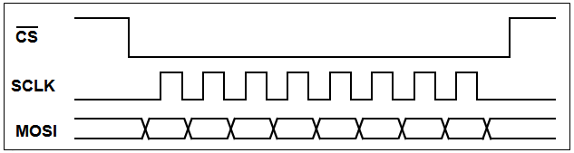
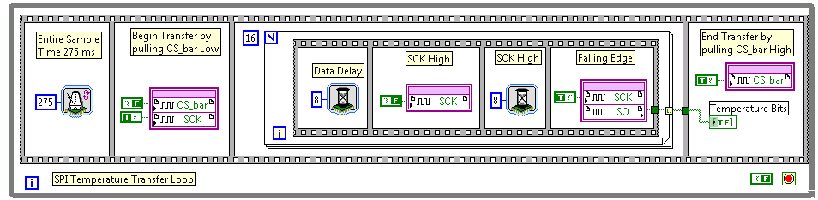
Digital Communication
Example – SPI
Notes:
For example, shown here is an implementation of SPI created in LabVIEW FPGA. The LabVIEW FPGA code (bottom) mimics the behavior of the timing diagram (top). Once created, the LabVIEW FPGA code can be copied and pasted multiple times to create a board that has many SPI communication lanes running in parallel.
Once again, recall that FPGAs are high-speed, low-jitter, and extremely parallel. They do have some limitations to the amount and type of processing that they can handle (which also depends on FPGA size), but those trade-offs will not be covered in this presentation.

Slide 25
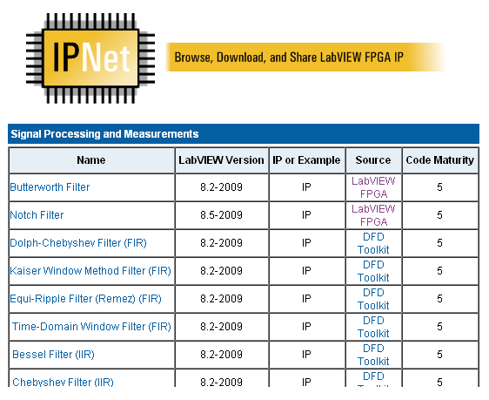
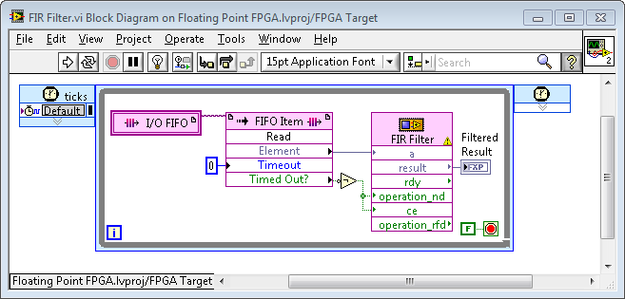
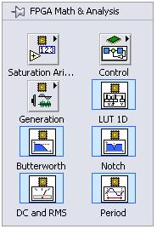
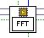
Built-In Intellectual Property (IP)
Importing and Reusing IP
FFT
DC/RMS
Waveform Averaging
Digital filtering
Windowing
Resampling
Notes:
Depending on the processing task, creating FPGA algorithms can be time consuming (especially given compile times). To speed development, the LabVIEW FPGA Module includes access to a wide variety of IP (intellectual property):
Built-in IP on the LabVIEW Functions Pallette
Hundreds of pieces of IP shared on ni.com/ipnet
Ability to import HDL IP
*New* LabVIEW now enables importing industry-standard Xilinx CORE Generator libraries

Slide 26
Part 3: Reconfigurable I/O (RIO) Architecture

Slide 27
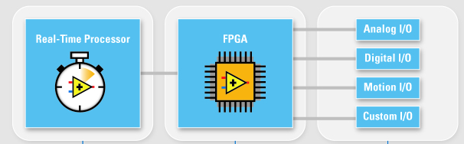
Reconfigurable I/O (RIO) Architecture
Notes:
At this point let’s tie it all together. There is a reason that the LabVIEW Real-Time and FPGA Modules are both included in the same presentation here.
Many National Instruments hardware products are based on an architecture that feature CPUs running a real-time OS, an FPGA, and I/O. This architecture is referred to as Reconfigurable I/O, or RIO. You will notice the term RIO in the titles of products like CompactRIO, Single-Board RIO, and FlexRIO.
When attached directly to I/O, the FPGA can simplify data, perform high-speed control or triggering, or provide reliable safety shut-offs. Then, the FPGA can pass data to the CPU (running LabVIEW Real-Time) for more intensive floating-point processing, logging to disk, or Ethernet transmission of data to a host PC user interface. Many successful designs have been implemented using this architecture.

Slide 28
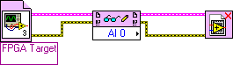
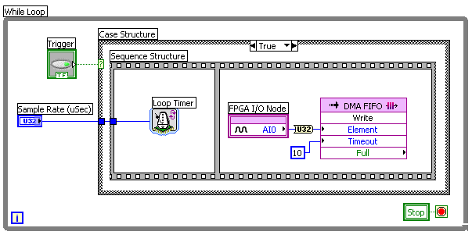
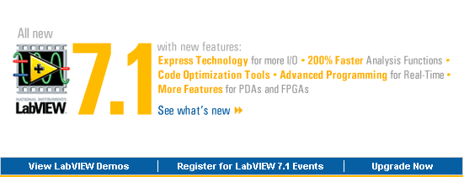

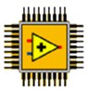
Communicating Between FPGA, CPU, and Other Systems
Remote Systems
Embedded CPU
FPGA
Physical I/O
Ethernet
DMA
LabVIEW
LabVIEW Real-Time
LabVIEW FPGA
Notes:
In the first (LabVIEW Real-Time) part of this presentation, most of the LabVIEW projects we looked at featured two programs (VIs): one to run on the embedded real-time CPU and another to run on the host PC (usually for the user interface).
Now, we will have three applications in our LabVIEW project: one for the FPGA, another for the real-time CPU, and a third for the remote user interface. In this case, the FPGA and CPU are located on the same CompactRIO device, so they will exchange data using DMA. Just as before, the embedded CPU will exchange data with the host system using Ethernet.

Slide 29

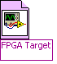
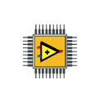
Default FPGA Personality: Scan Mode
NI CompactRIO
Real-Time Controller
FPGA
I/O Modules
I/O Modules
LabVIEW Real-Time
RIO Scan
Interface
NI Scan Engine
I/O Variables
I/O memory table
FPGA Host Interface
LabVIEW FPGA VI
Notes:
So why didn’t we need to program the CompactRIO FPGA earlier in this presentation (e.g. the temperature monitor)? We took advantage of a built-in feature known as Scan Mode.
Basically, if you want to use a device like the CompactRIO without programming the FPGA, you can use a pre-written bitfile for the FPGA that simply reads in I/O and passes those values to the real-time CPU. Or, when you are ready to customize the FPGA to perform high speed control, custom triggering, or other functions you can skip using Scan Mode and write a custom FPGA VI using the LabVIEW FPGA Module.
Due to time constraints, we won’t include an in-depth tutorial of using Scan Mode or programming the FPGA here. It is recommended that the audience attend a short CompactRIO hands-on course, and eventually the full LabVIEW Real-Time and FPGA Module training courses prior to developing/deploying their first application.

Slide 30
Demo: CompactRIO Motor Control System
Notes:
Presenters - for questions or troubleshooting, please contact:
Casey Weltzin
Product Manager, LabVIEW Real-Time
casey.weltzin@ni.com
521.683.6269
Estimated time: 5-10 minutes.
Open the “Demo 4 – FPGA Motor Control with Real-Time Commands” project file (should be loaded on PXI system for NITS). The goal of this demo is to present a sample use case for both the FPGA and real-time CPU on the CompactRIO. The FPGA is programmed to perform high-speed PID control of the motor using a position setpoint passed down from the LabVIEW Real-Time application. The real-time VI generates a function (sine wave, triangle wave, or square wave) to vary the motor position setpoint over time. Finally, a user interface application runs on the host PC to control which function is generated as well as the amplitude and frequency.
This is an open-and-run demo only.
Recommended steps:
Open the FPGA Motor Control with Real-Time Commands project file
Open the LabVIEW FPGA VI and explain its contents. This VI is responsible for controlling the motor using a PID algorithm, encoder signals from the motor, and a setpoint from the LabVIEW Real-Time VI. The motor speed is controlled using a PWM signal.
Open the LabVIEW Real-Time VI and explain its contents. This VI passes down a setpoint to the LabVIEW FPGA VI based on a simple function generator. This way, the motor will move reliably over time according to the function. The Real-Time VI receives an amplitude, frequency, and waveform type via Ethernet from a host application (Shared Variables).
Open the host VI and explain its contents. This VI takes user input and transmits desired waveform type, amplitude, and frequency to the embedded CompactRIO system.
Run the LabVIEW Real-Time VI (automatically runs the FPGA VI) and host VI. Experiment with changing the host VI settings and note the impact on the motor movement and UI indicators.
Optional: show the LabVIEW Real-Time and LabVIEW FPGA interactive debugging panels, and reiterate that these can be helpful for development but are not typically used with deployed applications.
Stop the real-time VI using the stop button on its debugging panel. Stop the user interface VI. Close all VIs and the project.

Slide 31

FedEx Express Fire Suppression System with NI Single-Board RIO
Application: Embedded temperature monitoring and control of a suppression system.
Challenge: Prototyping and deploying a cost-effective and reliable control solution for a fire suppression system for the main deck of a FedEx Express freighter aircraft while meeting a very aggressive deployment schedule.
Products: NI CompactRIO; LabVIEW; LabVIEW Real-Time, LabVIEW FPGA, and LabVIEW Touch Panel modules; and NI Single-Board RIO
Key Benefit: Rapid embedded prototyping with CompactRIO and LabVIEW, and fast deployment with NI Single-Board RIO.
“We were able to start with LabVIEW and CompactRIO for prototyping and quickly migrate our code to the new NI Single-Board RIO for deployment – all in less than a year.”
– Jeremy Snow, Ventura Aerospace

Slide 32
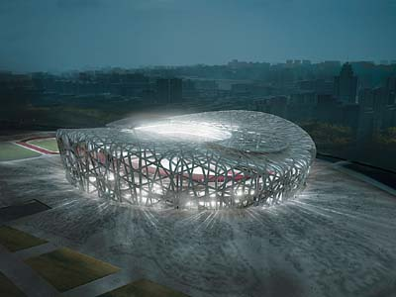
Performing Structural Health Monitoring of the 2008 Olympic Venues Using NI LabVIEW and CompactRIO
Application: Structural health monitoring (SHM) to determine stability, reliability, and livability of megastructures in China.
Challenge: Developing a reliable SHM system with continuous monitoring, rugged enclosure, GPS synchronization, and remote access.
Products: LabVIEW and CompactRIO
Key Benefit: Custom channel count per SHM system, GPS timing and synchronization, and off-the-shelf hardware to enable unmatched price/performance.
“Using National Instruments hardware and software, we designed, prototyped, and deployed a high-channel-count, SHM system with GPS synchronization in less than one year.”
– Chris McDonald, CGM Engineering

Slide 33

Siemens Wind Power Develops a Hardware-in-the-Loop Simulator for Wind Turbine Control System Software Testing
Application: A new real-time test system for hardware-in-the-loop (HIL) testing of the embedded control software releases of Siemens wind turbine control systems.
Challenge: Improving the automated testing of frequent software releases of Siemens wind turbine control systems as well as testing and verifying the wind turbine control system components in the development phase.
Products: LabVIEW, LabVIEW Real-Time Module, LabVIEW FPGA Module, LabVIEW Simulation Interface Toolkit, PXI-1042Q, PXI-8106, PXI-6704, PXI-6514, PXI-6515, PXI-6733, PXI-7813R, PXI-7833R, NI 9151, NI 9205, NI 9425, NI 9476, NI 9265, NI 9264
Key Benefit: The simulator provides an environment to effectively verify the new software releases and test special situations in our laboratory.
“The modular architecture allows us to scale-up the system to meet the growing requirements of rapidly evolving wind energy technology.” – Samir Bico, Siemens Wind Power A/S

Slide 34
Next Steps
Enroll in a hands-on LabVIEW Real-Time or FPGA training course (ni.com/training)
Embedded Evaluation kit available at ni.com/embeddedeval
Talk to your local NI representative or call to discuss your application

Slide 35
Auxiliary Slides (use if desired)

Slide 36
Additional LabVIEW Real-Time Information

Slide 37
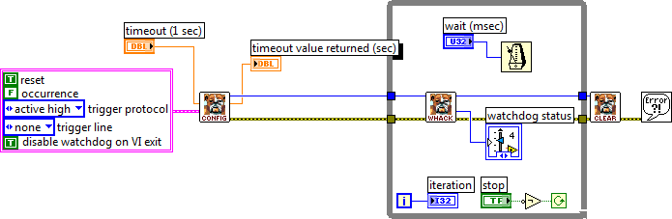
Designing for Reliability
Use watchdog timers to automatically reset a system or send a hardware signal if a problem occurs.

Slide 38
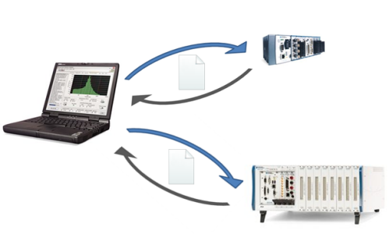
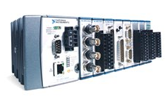
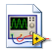
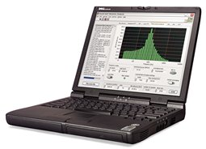
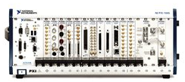
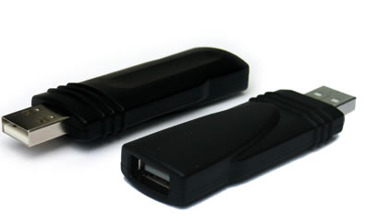
Replicating Real-Time Systems
Programmatically over the network
Programmatically over the network
OR
RT Desktop PC Utility USB drive

Slide 39
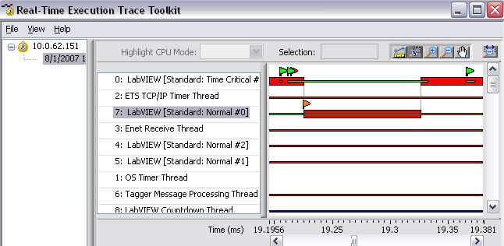
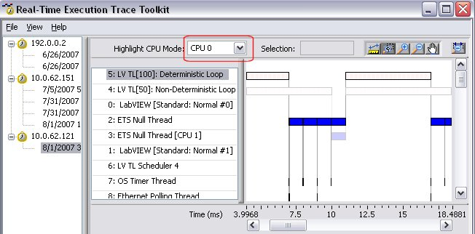
Thread-Level Debugging with the Real-Time Execution Trace Toolkit

Slide 40
New Features in the LabVIEW 2010 Real-Time Module

Slide 41
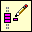

Network Streams
Simplified lossless buffered data transfer between two points

Slide 42
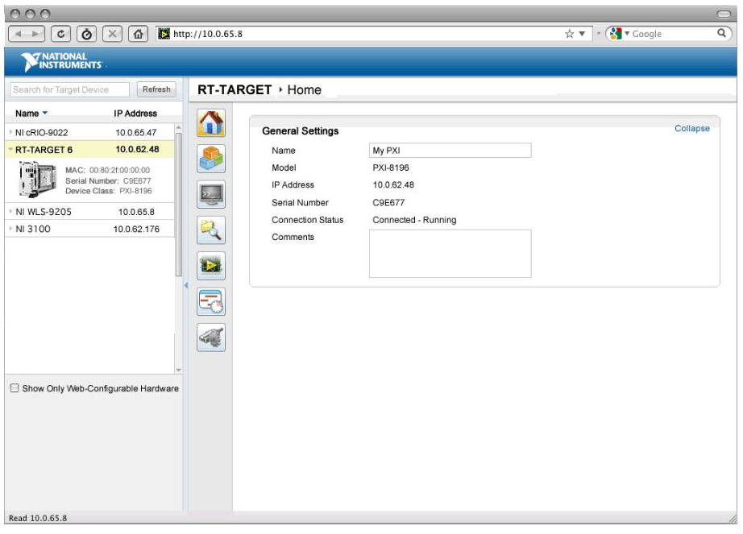
Web Monitoring and Configuration

Slide 43
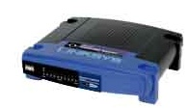
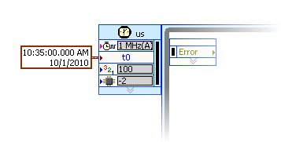
1588 Time Synchronization Across Targets

Slide 44
Running .m Files Deterministically with the Mathscript RT Module

Slide 45
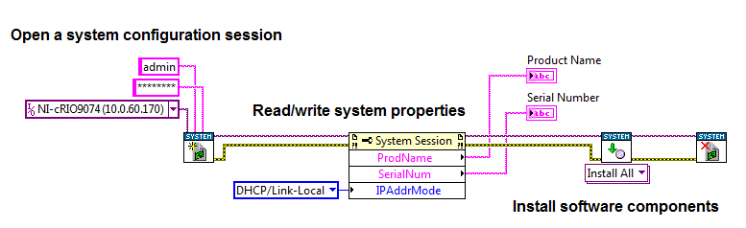
Programmatic Target Configuration

